Slide 1
Chapter 6: Process Synchronization

Slide 2
Module 6: Process Synchronization
Background
The Critical-Section Problem
Peterson’s Solution
Synchronization Hardware
Semaphores
Classic Problems of Synchronization
Monitors
Synchronization Examples
Atomic Transactions

Slide 3
Background
Concurrent access to shared data may result in data inconsistency
Maintaining data consistency requires mechanisms to ensure the orderly execution of cooperating processes
Suppose that we wanted to provide a solution to the consumer-producer problem that fills all the buffers. We can do so by having an integer count that keeps track of the number of full buffers. Initially, count is set to 0. It is incremented by the producer after it produces a new buffer and is decremented by the consumer after it consumes a buffer.

Slide 4
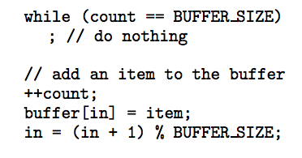
Producer

Slide 5
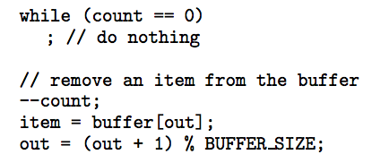
Consumer

Slide 6
Race Condition
count++ could be implemented as
register1 = count
register1 = register1 + 1
count = register1
count-- could be implemented as
register2 = count
register2 = register2 - 1
count = register2
Consider this execution interleaving with “count = 5” initially:
  S0: producer execute register1 = count {register1 = 5}
  S1: producer execute register1 = register1 + 1 {register1 = 6}
  S2: consumer execute register2 = count {register2 = 5}
  S3: consumer execute register2 = register2 - 1 {register2 = 4}
  S4: producer execute count = register1 {count = 6 }
  S5: consumer execute count = register2 {count = 4}

Slide 7
Solution to Critical-Section Problem
1. Mutual Exclusion - If process P_{i} is executing in its critical section, then no other processes can be executing in their critical sections
2. Progress - If no process is executing in its critical section and there exist some processes that wish to enter their critical section, then the selection of the processes that will enter the critical section next cannot be postponed indefinitely
3. Bounded Waiting - A bound must exist on the number of times that other processes are allowed to enter their critical sections after a process has made a request to enter its critical section and before that request is granted
  Assume that each process executes at a nonzero speed
  No assumption concerning relative speed of the N processes

Slide 8
Critical-Section Problem
Race Condition - When there is concurrent access to shared data and the final outcome depends upon order of execution.
Critical Section - Section of code where shared data is accessed.
Entry Section - Code that requests permission to enter its critical section.
Exit Section - Code that is run after exiting the critical section

Slide 9
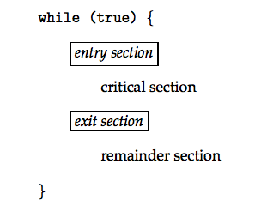
Structure of a Typical Process

Slide 10
Peterson’s Solution
Two process solution
Assume that the LOAD and STORE instructions are atomic; that is, cannot be interrupted.
The two processes share two variables:
  int turn;
  Boolean flag[2]
The variable turn indicates whose turn it is to enter the critical section.
The flag array is used to indicate if a process is ready to enter the critical section. flag[i] = true implies that process P_{i} is ready!

Slide 11
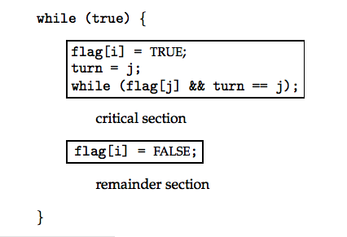
Algorithm for Process P_{i}

Slide 12
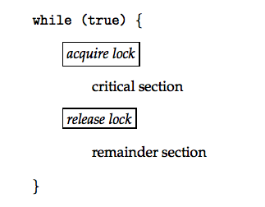
Critical Section Using Locks

Slide 13
Synchronization Hardware
Many systems provide hardware support for critical section code
Uniprocessors – could disable interrupts
  Currently running code would execute without preemption
  Generally too inefficient on multiprocessor systems
    Operating systems using this not broadly scalable
Modern machines provide special atomic hardware instructions
    Atomic = non-interruptible
  Either test memory word and set value
  Or swap contents of two memory words

Slide 14
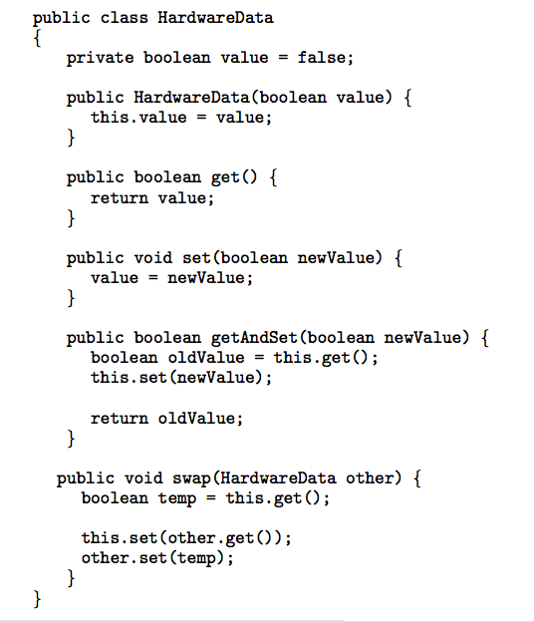
Data Structure for Hardware Solutions

Slide 15
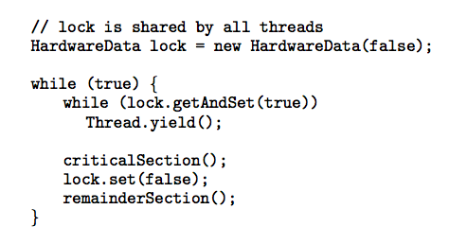
Solution using GetAndSet

Slide 16
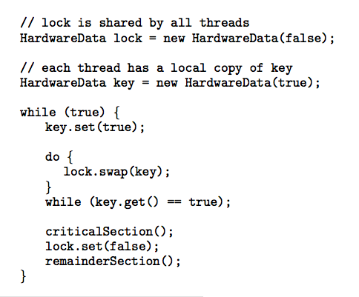
Solution using Swap

Slide 17
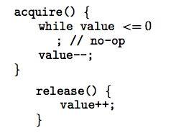
Semaphore
Synchronization tool that does not require busy waiting
Semaphore S – integer variable
Two standard operations modify S: acquire() and release()
  Originally called P() and V()
Less complicated
Can only be accessed via two indivisible (atomic) operations

Slide 18
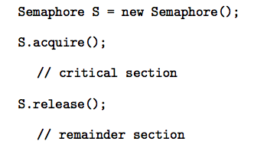
Semaphore as General Synchronization Tool
Counting semaphore – integer value can range over an unrestricted domain
Binary semaphore – integer value can range only between 0
and 1; can be simpler to implement
  Also known as mutex locks

Slide 19
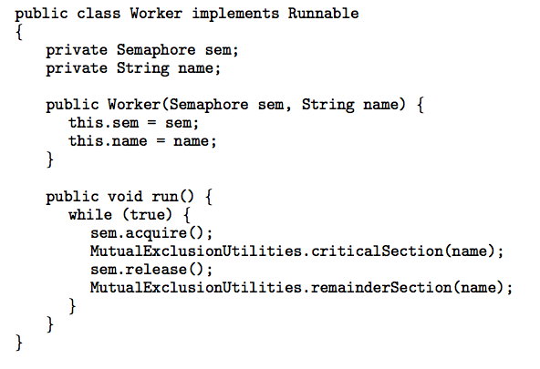
Java Example Using Semaphores

Slide 20
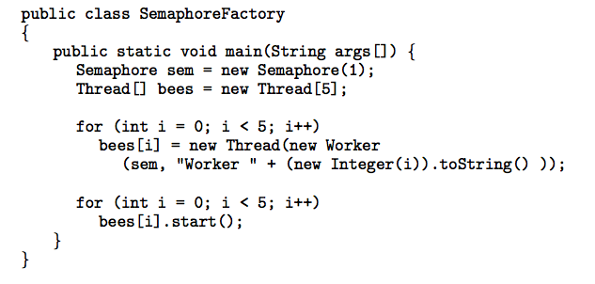
Java Example Using Semaphores

Slide 21
Semaphore Implementation
Must guarantee that no two processes can execute acquire () and release () on the same semaphore at the same time
Thus, implementation becomes the critical section problem where the wait and signal code are placed in the crtical section.
  Could now have busy waiting in critical section implementation
    But implementation code is short
    Little busy waiting if critical section rarely occupied
Note that applications may spend lots of time in critical sections and therefore this is not a good solution.

Slide 22
Semaphore Implementation with no Busy waiting
With each semaphore there is an associated waiting queue. Each entry in a waiting queue has two data items:
  value (of type integer)
  pointer to next record in the list
Two operations:
  block – place the process invoking the operation on the appropriate waiting queue.
  wakeup – remove one of processes in the waiting queue and place it in the ready queue.

Slide 23
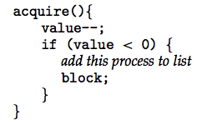
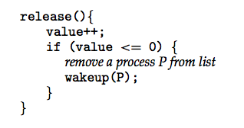
Semaphore Implementation with no Busy waiting (Cont.)
Implementation of acquire():
Implementation of release():

Slide 24
Deadlock and Starvation
Deadlock – two or more processes are waiting indefinitely for an event that can be caused by only one of the waiting processes
Let S and Q be two semaphores initialized to 1
P₀ P₁
S.acquire(); Q.acquire();
Q.acquire(); S.acquire();
. .
. .
. .
S.release(); Q.release();
Q.release(); S.release();
Starvation – indefinite blocking. A process may never be removed from the semaphore queue in which it is suspended.

Slide 25
Classical Problems of Synchronization
Bounded-Buffer Problem
Readers and Writers Problem
Dining-Philosophers Problem

Slide 26
Bounded-Buffer Problem
N buffers, each can hold one item
Semaphore mutex initialized to the value 1
Semaphore full initialized to the value 0
Semaphore empty initialized to the value N.

Slide 27
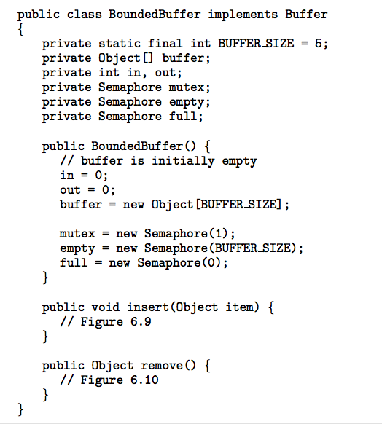
Bounded-Buffer Problem

Slide 28
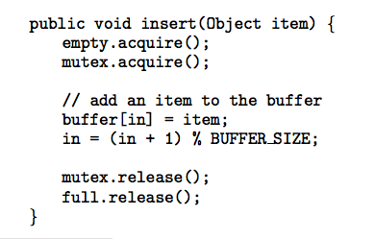
Bounded-Buffer Problem
insert() Method

Slide 29
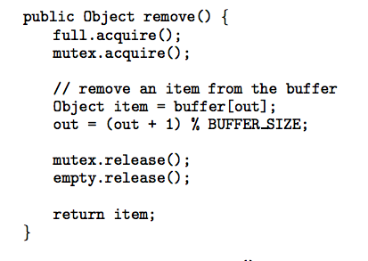
Bounded-Buffer Problem
remove() Method

Slide 30
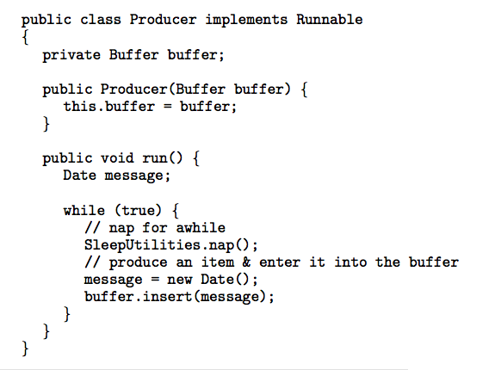
Bounded Buffer Problem (Cont.)
The structure of the producer process

Slide 31
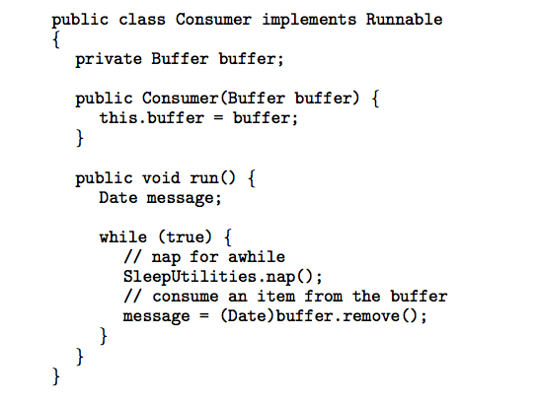
Bounded Buffer Problem (Cont.)
The structure of the consumer process

Slide 32
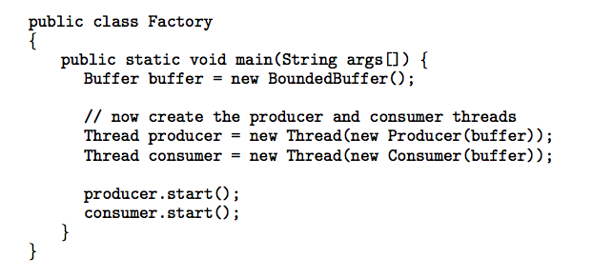
Bounded Buffer Problem (Cont.)
The Factory

Slide 33
Readers-Writers Problem
A data set is shared among a number of concurrent processes
  Readers – only read the data set; they do not perform any updates
  Writers – can both read and write.
Problem – allow multiple readers to read at the same time. Only one single writer can access the shared data at the same time.
Shared Data
  Data set
  Semaphore mutex initialized to 1.
  Semaphore db initialized to 1.
  Integer readerCount initialized to 0.

Slide 34
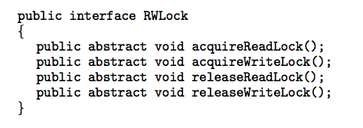
Readers-Writers Problem
Interface for read-write locks

Slide 35
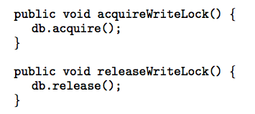
Readers-Writers Problem
Methods called by writers.

Slide 36
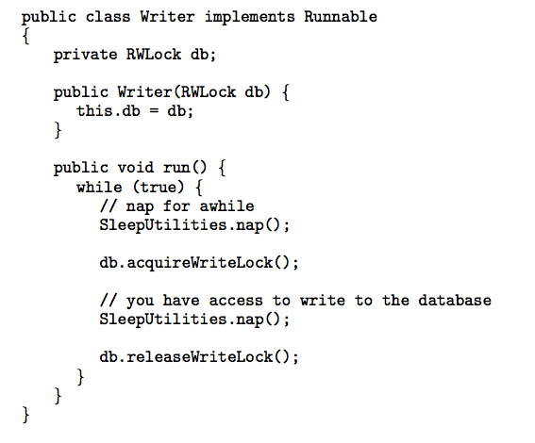
Readers-Writers Problem
The structure of a writer process

Slide 37
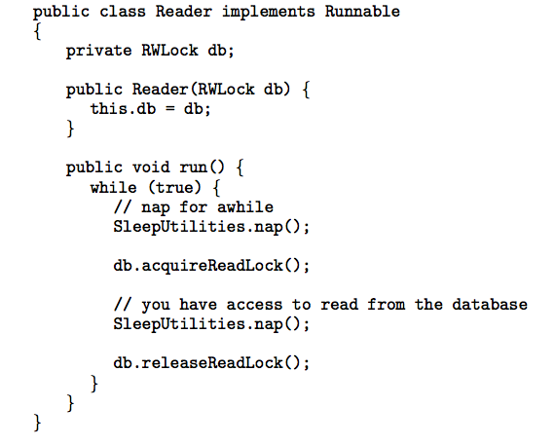
Readers-Writers Problem
The structure of a reader process

Slide 38
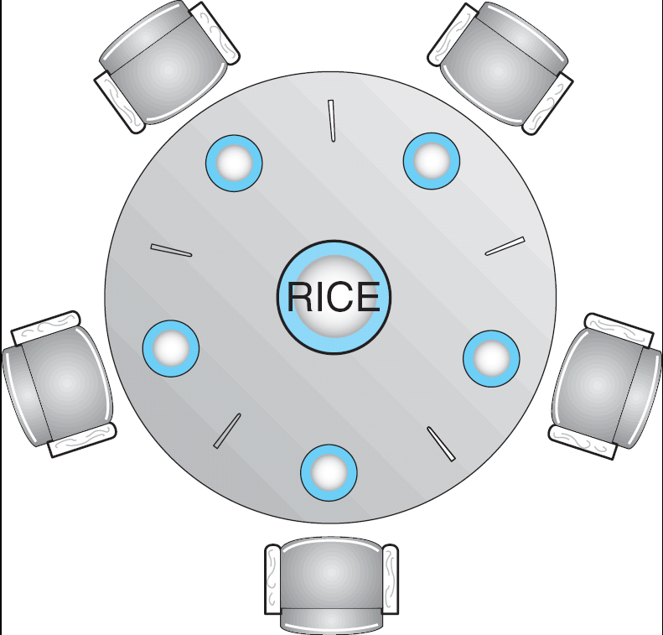
Dining-Philosophers Problem
Shared data
  Bowl of rice (data set)
  Semaphore chopStick [5] initialized to 1

Slide 39
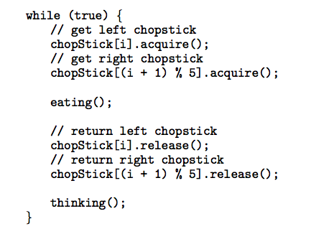
Dining-Philosophers Problem (Cont.)
The structure of Philosopher i:

Slide 40
Problems with Semaphores
Correct use of semaphore operations:
  mutex.acquire() …. mutex.release()
  mutex.wait() … mutex.wait()
  Omitting of mutex.wait () or mutex.release() (or both)

Slide 41
Monitors
A high-level abstraction that provides a convenient and effective mechanism for process synchronization
Only one process may be active within the monitor at a time

Slide 42
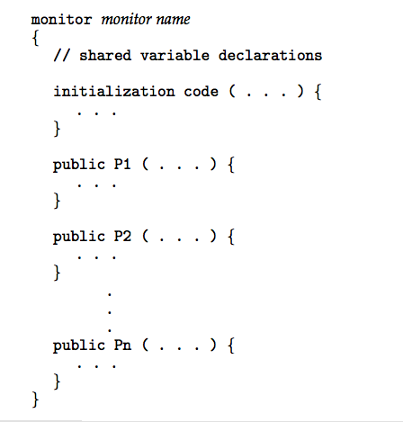
Syntax of a Monitor

Slide 43

Schematic view of a Monitor

Slide 44
Condition Variables
Condition x, y;
Two operations on a condition variable:
  x.wait () – a process that invokes the operation is suspended.
  x.signal () – resumes one of processes (if any) that invoked x.wait ()

Slide 45

Monitor with Condition Variables

Slide 46
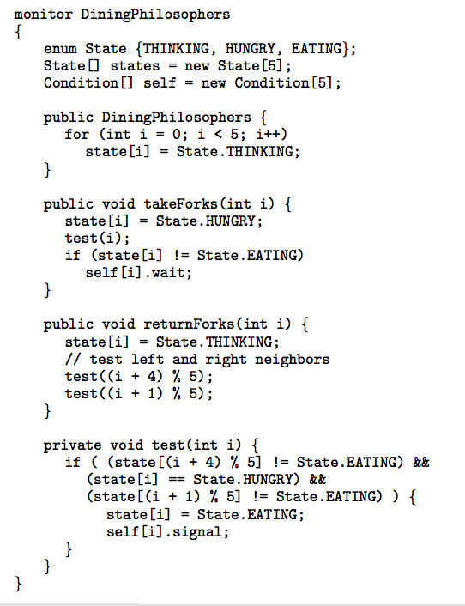
Solution to Dining Philosophers

Slide 47
Solution to Dining Philosophers (cont)
Each philosopher I invokes the operations takeForks(i) and returnForks(i) in the following sequence:
dp.takeForks (i)
EAT
dp.returnForks (i)

Slide 48
Java Synchronization
Java provides synchronization at the language-level.
Each Java object has an associated lock.
This lock is acquired by invoking a synchronized method.
This lock is released when exiting the synchronized method.
Threads waiting to acquire the object lock are placed in the entry set for the object lock.

Slide 49
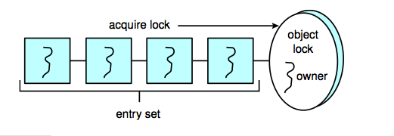
Java Synchronization
Each object has an associated entry set.

Slide 50
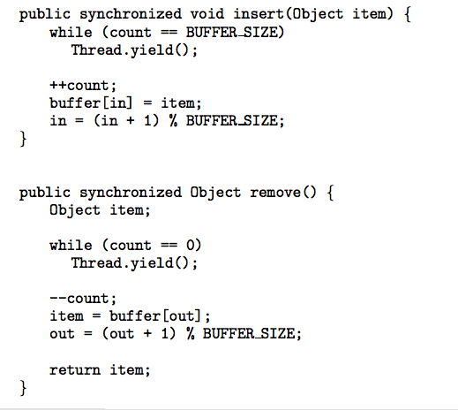
Java Synchronization
Synchronized insert() and remove() methods

Slide 51
Java Synchronization wait/notify()
When a thread invokes wait():
1. The thread releases the object lock;
2. The state of the thread is set to Blocked;
3. The thread is placed in the wait set for the object.
When a thread invokes notify():
1. An arbitrary thread T from the wait set is selected;
2. T is moved from the wait to the entry set;
3. The state of T is set to Runnable.

Slide 52
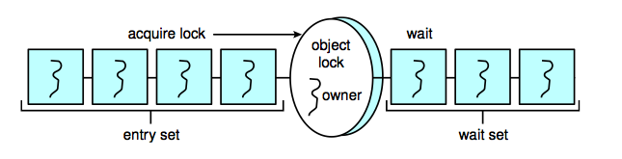
Java Synchronization
Entry and wait sets

Slide 53
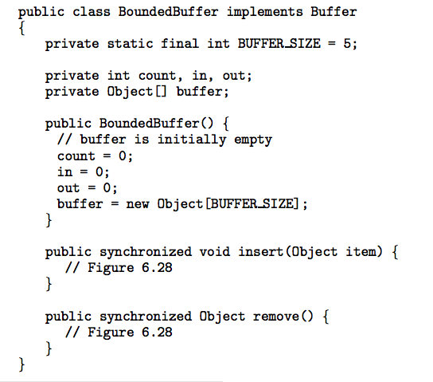
Java Synchronization - Bounded Buffer

Slide 54
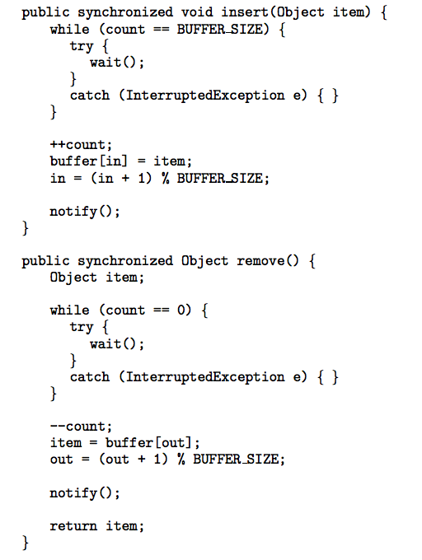
Java Synchronization - Bounded Buffer

Slide 55
Java Synchronization
The call to notify() selects an aribitrary thread from the wait set. It is possible the selected thread is in fact not waiting upon the condition for which it was notified.
The call notifyAll() selects all threads in the wait set and moves them to the entry set.
In general, notifyAll() is a more conservative strategy than notify().

Slide 56
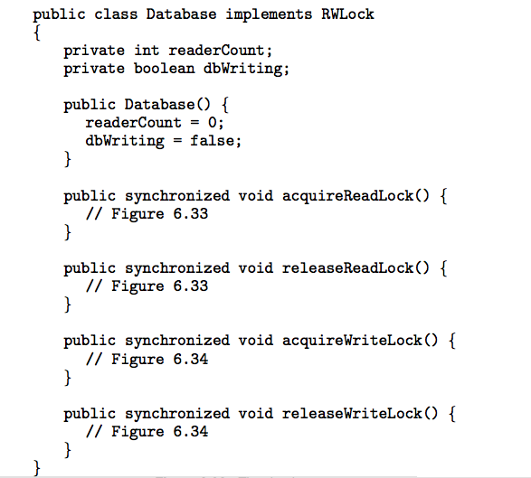
Java Synchronization - Readers-Writers

Slide 57
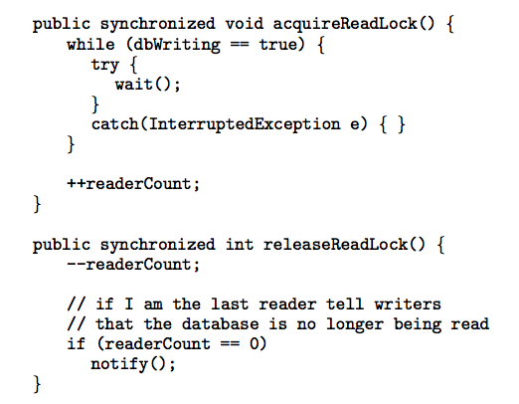
Java Synchronization - Readers-Writers
Methods called by readers

Slide 58
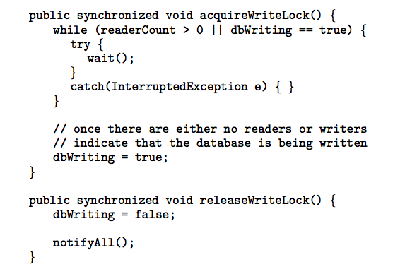
Java Synchronization - Readers-Writers
Methods called by writers

Slide 59
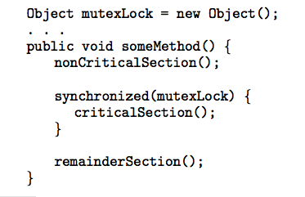
Java Synchronization
Rather than synchronizing an entire method,
blocks of code may be declared as synchronized

Slide 60
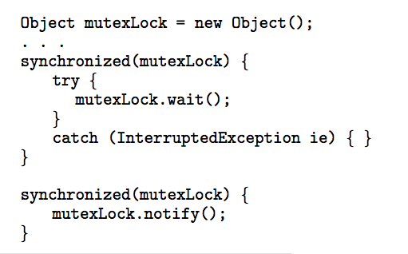
Java Synchronization
Block synchronization using wait()/notify()

Slide 61
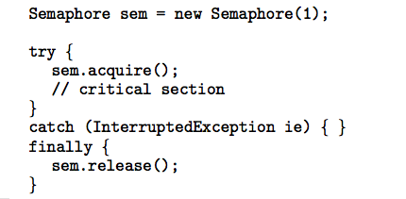
Concurrency Features in Java 5
Semaphores

Slide 62

Concurrency Features in Java 5
A condition variable is created by first creating a
ReentrantLock and invoking its newCondition() method:
Once this is done, it is possible to invoke the
await() and signal() methods.

Slide 63
Synchronization Examples
Solaris
Windows XP
Linux
Pthreads

Slide 64
Solaris Synchronization
Implements a variety of locks to support multitasking, multithreading (including real-time threads), and multiprocessing
Uses adaptive mutexes for efficiency when protecting data from short code segments
Uses condition variables and readers-writers locks when longer sections of code need access to data
Uses turnstiles to order the list of threads waiting to acquire either an adaptive mutex or reader-writer lock

Slide 65
Windows XP Synchronization
Uses interrupt masks to protect access to global resources on uniprocessor systems
Uses spinlocks on multiprocessor systems
Also provides dispatcher objects which may act as either mutexes and semaphores
Dispatcher objects may also provide events
  An event acts much like a condition variable

Slide 66
Linux Synchronization
Linux:
  disables interrupts to implement short critical sections
Linux provides:
  semaphores
  spin locks

Slide 67
Pthreads Synchronization
Pthreads API is OS-independent
It provides:
  mutex locks
  condition variables
Non-portable extensions include:
  read-write locks
  spin locks

Slide 68
Atomic Transactions
System Model
Log-based Recovery
Checkpoints
Concurrent Atomic Transactions

Slide 69
System Model
Assures that operations happen as a single logical unit of work, in its entirety, or not at all
Related to field of database systems
Challenge is assuring atomicity despite computer system failures
Transaction - collection of instructions or operations that performs single logical function
  Here we are concerned with changes to stable storage – disk
  Transaction is series of read and write operations
  Terminated by commit (transaction successful) or abort (transaction failed) operation
  Aborted transaction must be rolled back to undo any changes it performed

Slide 70
Types of Storage Media
Volatile storage – information stored here does not survive system crashes
  Example: main memory, cache
Nonvolatile storage – Information usually survives crashes
  Example: disk and tape
Stable storage – Information never lost
  Not actually possible, so approximated via replication or RAID to devices with independent failure modes
Goal is to assure transaction atomicity where failures cause loss of information on volatile storage

Slide 71
Log-Based Recovery
Record to stable storage information about all modifications by a transaction
Most common is write-ahead logging
  Log on stable storage, each log record describes single transaction write operation, including
    Transaction name
    Data item name
    Old value
    New value
  <T_{i} starts> written to log when transaction T_{i} starts
  <T_{i} commits> written when T_{i} commits
Log entry must reach stable storage before operation on data occurs

Slide 72
Log-Based Recovery Algorithm
Using the log, system can handle any volatile memory errors
  Undo(T_{i}) restores value of all data updated by T_{i}
  Redo(T_{i}) sets values of all data in transaction T_{i} to new values
Undo(T_{i}) and redo(T_{i}) must be idempotent
  Multiple executions must have the same result as one execution
If system fails, restore state of all updated data via log
  If log contains <T_{i} starts> without <T_{i} commits>, undo(T_{i})
  If log contains <T_{i} starts> and <T_{i} commits>, redo(T_{i})

Slide 73
Checkpoints
Log could become long, and recovery could take long
Checkpoints shorten log and recovery time.
Checkpoint scheme:
  Output all log records currently in volatile storage to stable storage
  Output all modified data from volatile to stable storage
  Output a log record <checkpoint> to the log on stable storage
Now recovery only includes Ti, such that Ti started executing before the most recent checkpoint, and all transactions after Ti All other transactions already on stable storage

Slide 74
Concurrent Transactions
Must be equivalent to serial execution – serializability
Could perform all transactions in critical section
  Inefficient, too restrictive
Concurrency-control algorithms provide serializability

Slide 75
Serializability
Consider two data items A and B
Consider Transactions T₀ and T₁
Execute T₀, T₁ atomically
Execution sequence called schedule
Atomically executed transaction order called serial schedule
For N transactions, there are N! valid serial schedules

Slide 76

Schedule 1: T₀ then T₁

Slide 77
Nonserial Schedule
Nonserial schedule allows overlapped execute
  Resulting execution not necessarily incorrect
Consider schedule S, operations O_{i}, O_{j}
  Conflict if access same data item, with at least one write
If O_{i}, O_{j} consecutive and operations of different transactions & O_{i} and O_{j} don’t conflict
  Then S’ with swapped order O_{j} O_{i} equivalent to S
If S can become S’ via swapping nonconflicting operations
  S is conflict serializable

Slide 78

Schedule 2: Concurrent Serializable Schedule

Slide 79
Locking Protocol
Ensure serializability by associating lock with each data item
  Follow locking protocol for access control
Locks
  Shared – T_{i} has shared-mode lock (S) on item Q, T_{i} can read Q but not write Q
  Exclusive – Ti has exclusive-mode lock (X) on Q, T_{i} can read and write Q
Require every transaction on item Q acquire appropriate lock
If lock already held, new request may have to wait
  Similar to readers-writers algorithm

Slide 80
Two-phase Locking Protocol
Generally ensures conflict serializability
Each transaction issues lock and unlock requests in two phases
  Growing – obtaining locks
  Shrinking – releasing locks
Does not prevent deadlock

Slide 81
Timestamp-based Protocols
Select order among transactions in advance – timestamp-ordering
Transaction T_{i} associated with timestamp TS(T_{i}) before T_{i} starts
  TS(T_{i}) < TS(T_{j}) if Ti entered system before T_{j}
  TS can be generated from system clock or as logical counter incremented at each entry of transaction
Timestamps determine serializability order
  If TS(T_{i}) < TS(T_{j}), system must ensure produced schedule equivalent to serial schedule where T_{i} appears before T_{j}

Slide 82
Timestamp-based Protocol Implementation
Data item Q gets two timestamps
  W-timestamp(Q) – largest timestamp of any transaction that executed write(Q) successfully
  R-timestamp(Q) – largest timestamp of successful read(Q)
  Updated whenever read(Q) or write(Q) executed
Timestamp-ordering protocol assures any conflicting read and write executed in timestamp order
Suppose Ti executes read(Q)
  If TS(T_{i}) < W-timestamp(Q), Ti needs to read value of Q that was already overwritten
    read operation rejected and T_{i} rolled back
  If TS(T_{i}) ≥ W-timestamp(Q)
    read executed, R-timestamp(Q) set to max(R-timestamp(Q), TS(T_{i}))

Slide 83
Timestamp-ordering Protocol
Suppose Ti executes write(Q)
  If TS(T_{i}) < R-timestamp(Q), value Q produced by T_{i} was needed previously and T_{i} assumed it would never be produced
    Write operation rejected, T_{i} rolled back
  If TS(T_{i}) < W-tiimestamp(Q), T_{i} attempting to write obsolete value of Q
    Write operation rejected and T_{i} rolled back
  Otherwise, write executed
Any rolled back transaction T_{i} is assigned new timestamp and restarted
Algorithm ensures conflict serializability and freedom from deadlock

Slide 84

Schedule Possible Under Timestamp Protocol

Slide 85
End of Chapter 6

